Slide 1
Precision Timing for Digital Substations
Fred Steinhauser, Digital Substation Evangelist

Slide 2
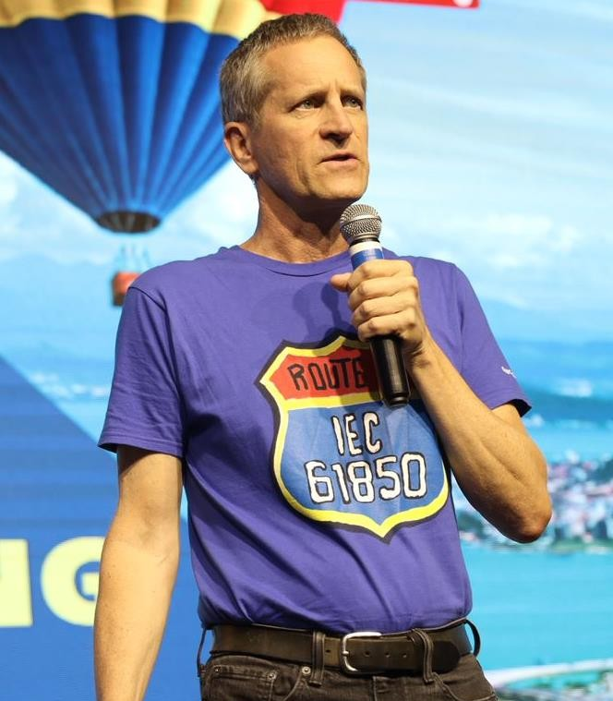



Who I am
University of Technology Vienna
1981-1990
Master, Ph.D., Research Assistant
Process Automation & IT in textile industry
1990-1998
OMICRON
1998-2014 | Product Management
2001-... | Involvement into IEC 61850
2014-... | Fully dedicated to Power Utility Communication
2018-... | Digital Substation Evangelist

Slide 3
and Precision Timing?
Test equipment for testing power system assets
Protection Testing End-to-End testing
Distributed, time synchronized testing (since about 1993)
Power Utility Communication – IEC 61850
Assessment of communication networks for Digital Substations Propagation delays, ...
Distributed, time synchronized testing
Tools made for electrical power engineers
Different usability than for, e.g., telecom engineers

Slide 4
Applications Depending on Precision Timing
Much fostered by the advent of GNSS
Differential protection
Fault location
Synchrophasors
End-to-End testing
Fault analysis

Slide 5


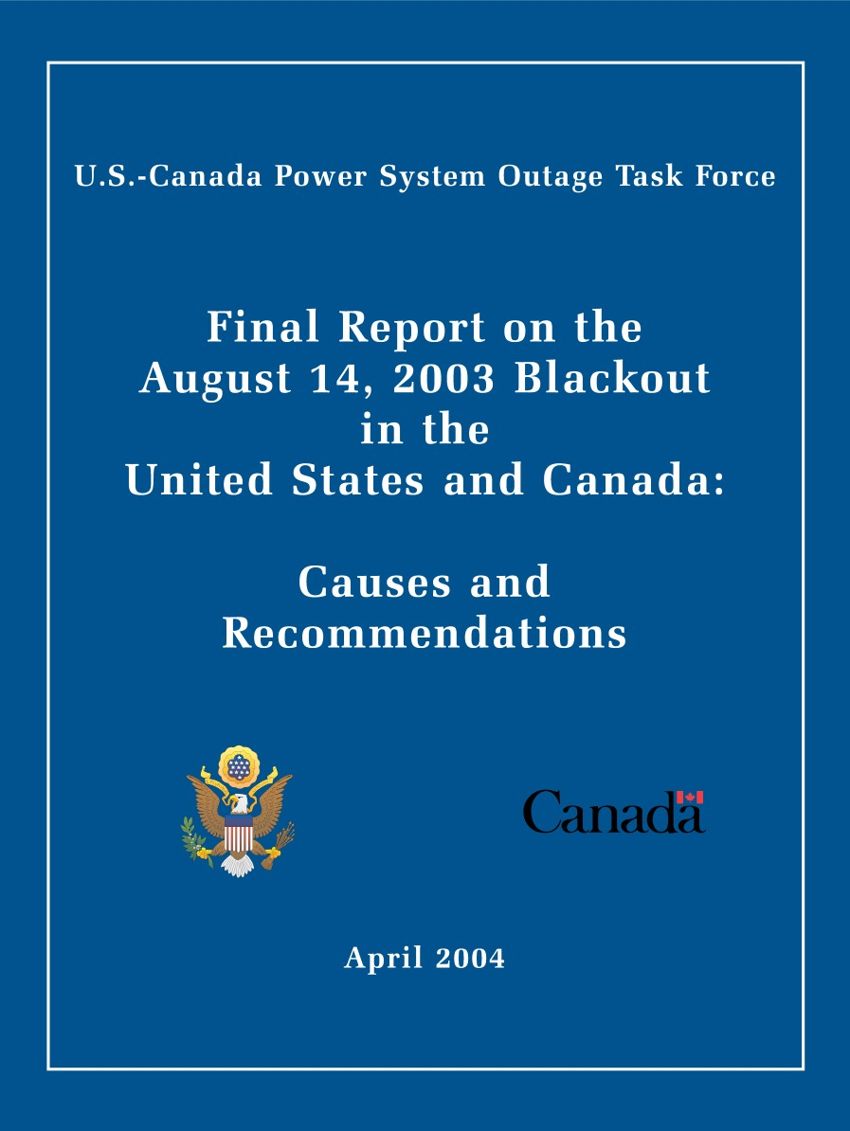
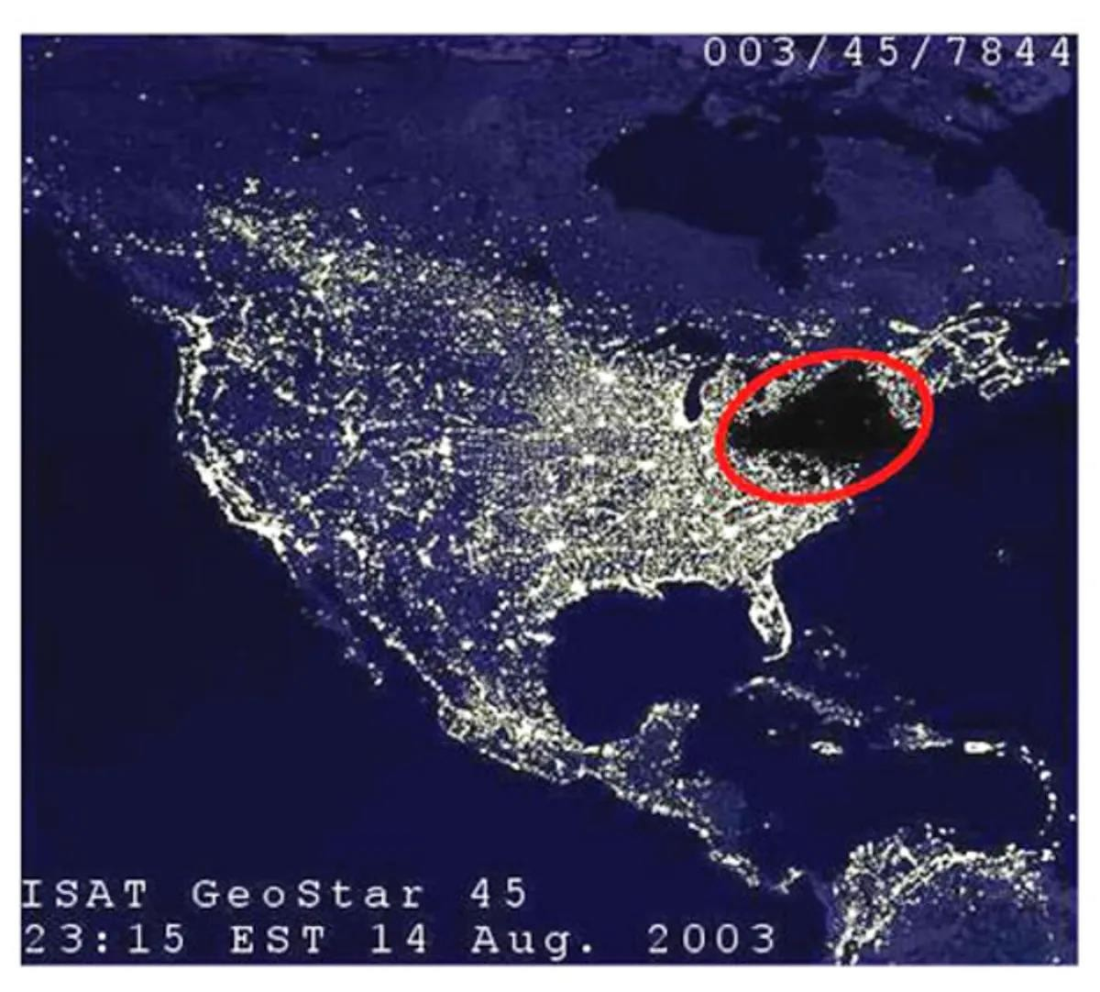
Fault Analysis
2003 Blackout

Slide 6

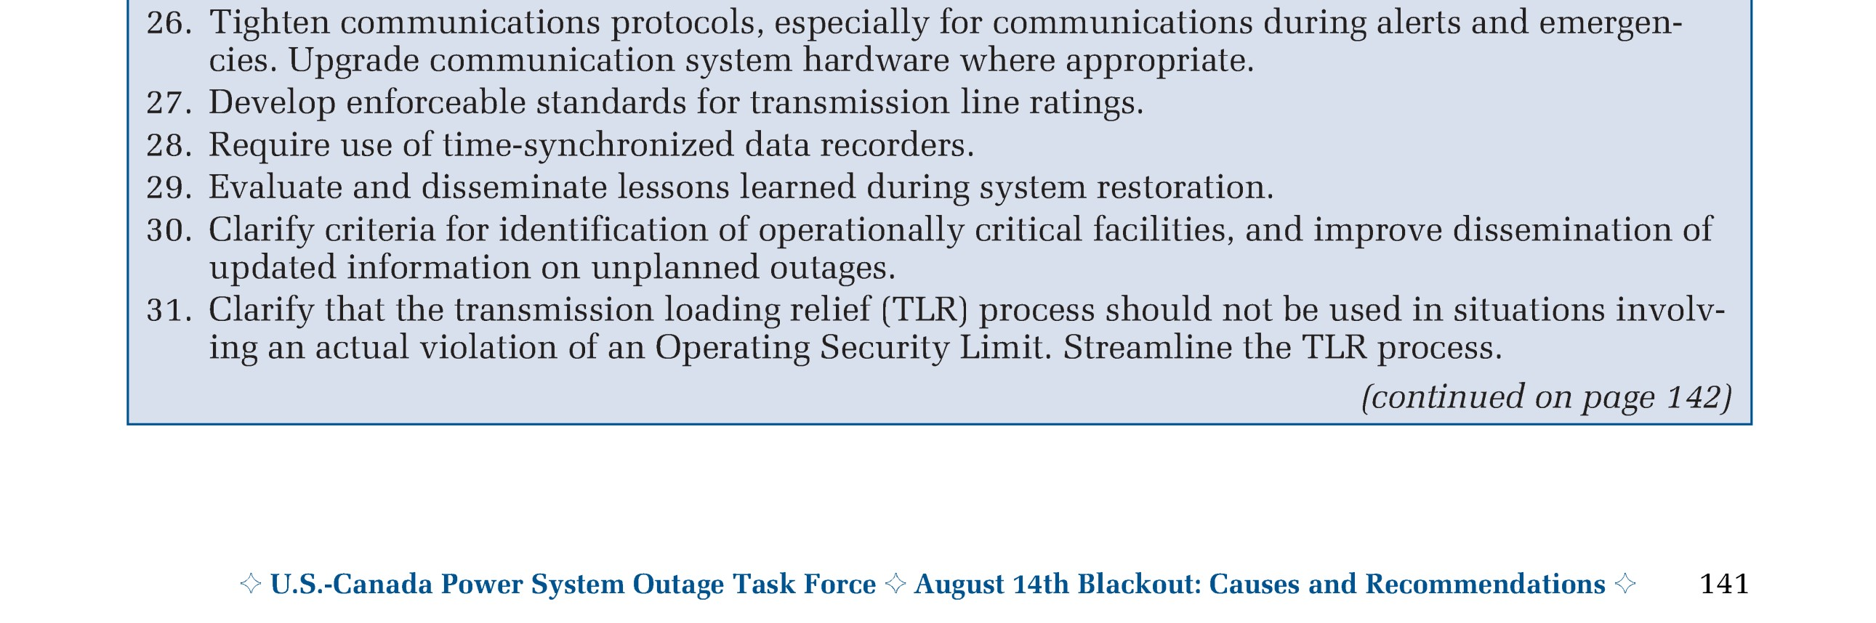
2003 Blackout
Proposed measures

Slide 7
Applications on the Uncertainty Scale
Well covered with PTP (and related profiles)
Control SCADA logs
Sequence of events
Self-synchronizing Differential protection
Synchrophasors
Sampled
Values
Fault
location
1 s
1 ms
1 µs
1 ns

Slide 8
Application Uncertainty Reference
Power system frequencies – 50 Hz / 60 Hz
Time Error | Phase Error @ 50 Hz | Phase Error @ 60 Hz
1 ms | 18° | 21.6°
100 µs | 1.8° | 2.2°
55.5 µs | 1.0° | 1.2°
46,3 µs | 0.8° | 1.0°
Ballpark figures
50 µs ≈ 1°
5 µs ≈ 0.1°
1 µs ≈ 1.2 minutes
(360° corresponds to one cycle of the power system)

Slide 9
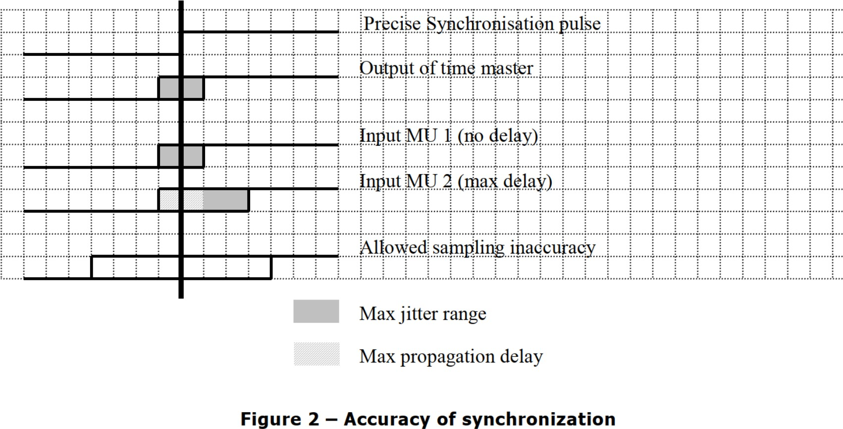
Sampled Values: Sampling Timing in "9-2LE"
1µs

Slide 10
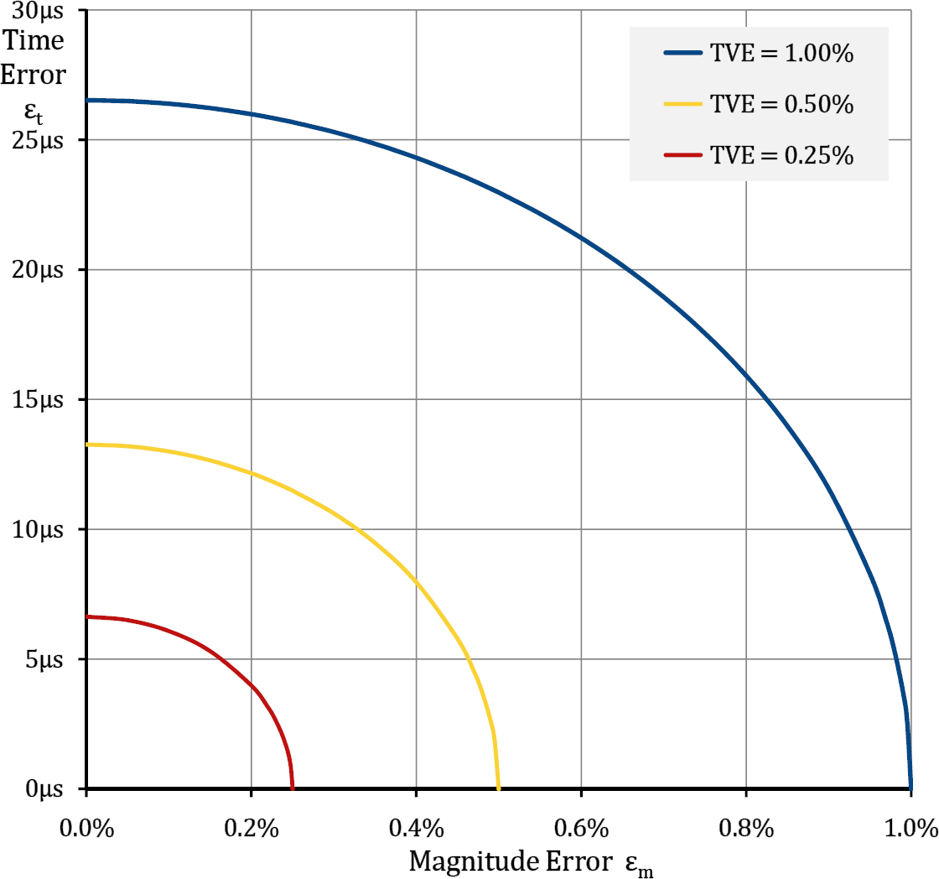
Requirements for PMUs
Total Vector Error
(Total Phasor Error)
Combination of errors
Magnitude error Phase- (time-) error
PMUs work well ...
... with time uncertainties of about 10 µs

Slide 11
PTP Profiles
IEC 61850-9-3
Power Utility Profile
Close to the Standard Profile Basic profile
IEEE C37.238
Power Profile
Common properties
Layer 2
Peer-to-peer

Slide 12
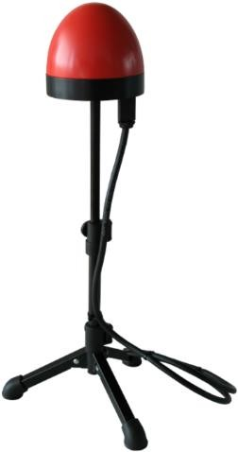
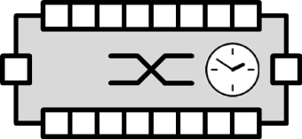
Accuracy along the time distribution chain
Maximum time synchronization uncertainty
1 µs over 16 hops
1 hop
IED to be
synchronized
± 50 ns
max. 16 hops
max. 16 ∙± 50 ns = ± 800 ns
± 200 ns

Slide 13

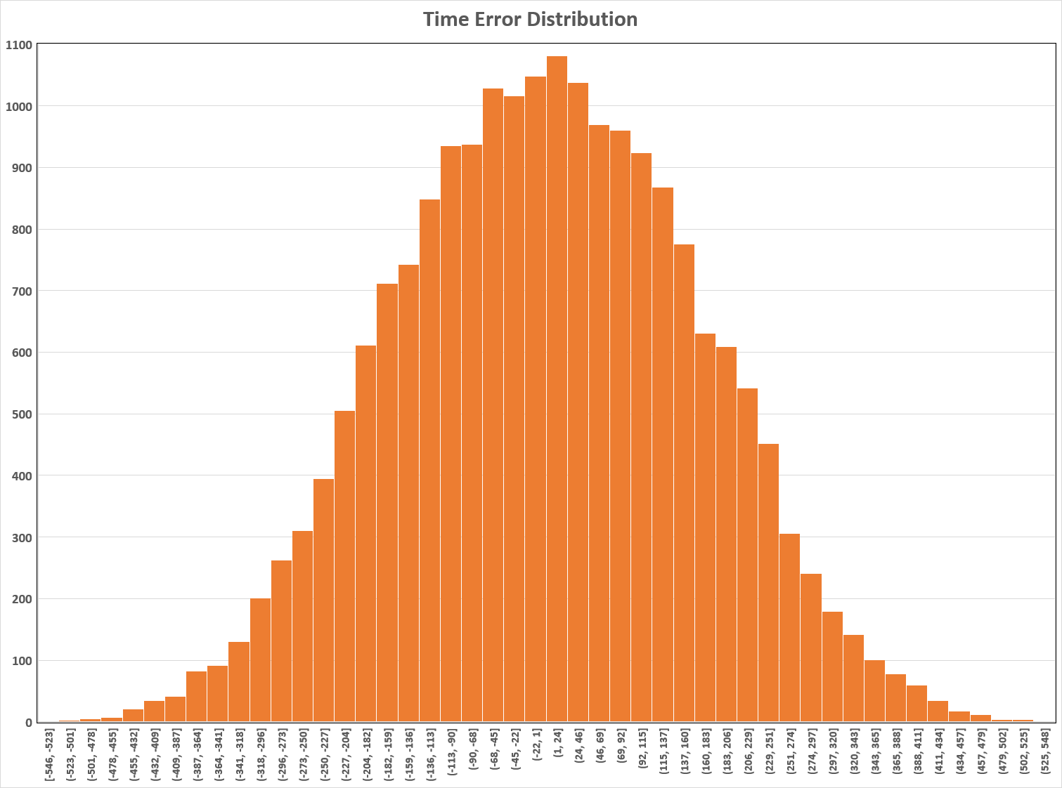

Accuracy along the time distribution chain
Assume uniform distribution at the "contributors" Uniform distribution = conservative assumption Master clock
2 ∙ 𝜎_{CH}
Transparent clock
Do the math ...
... for the entire chain with 16 hops
Matches simulation
-550 ns
+550 ns

Slide 14
The Power Utility Mindset

Slide 15
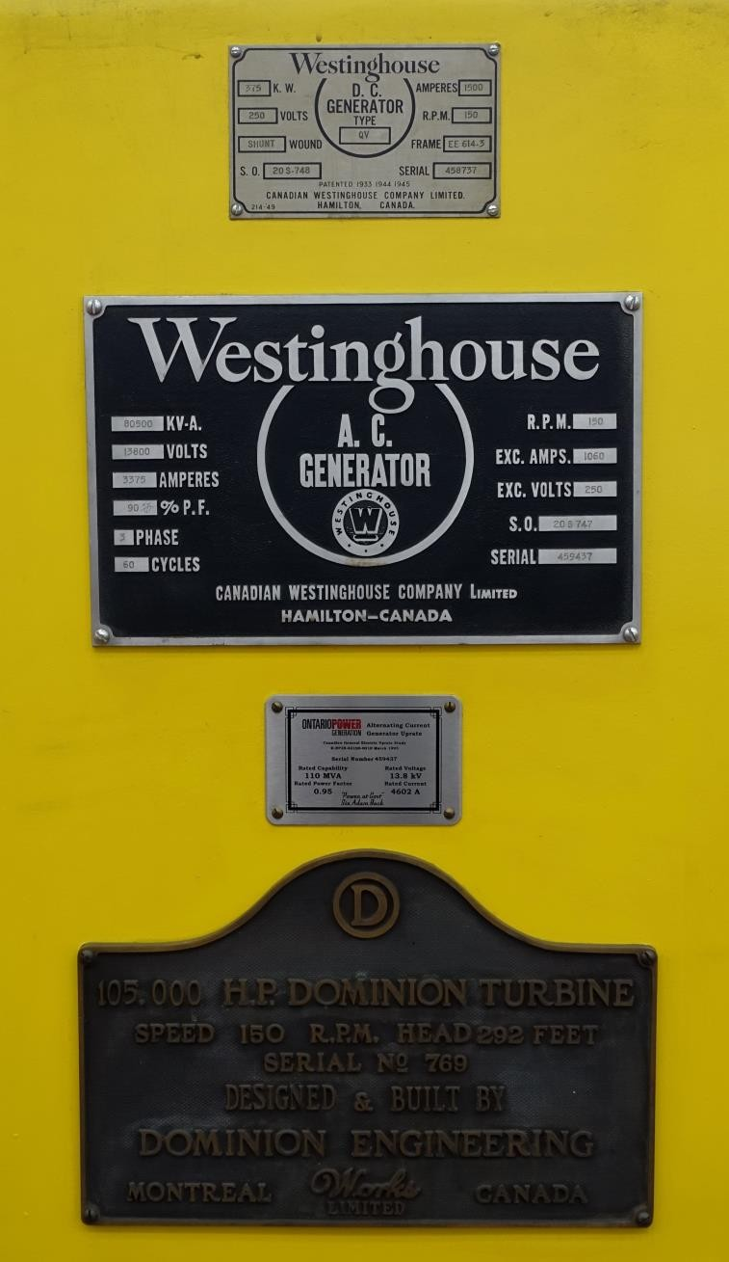
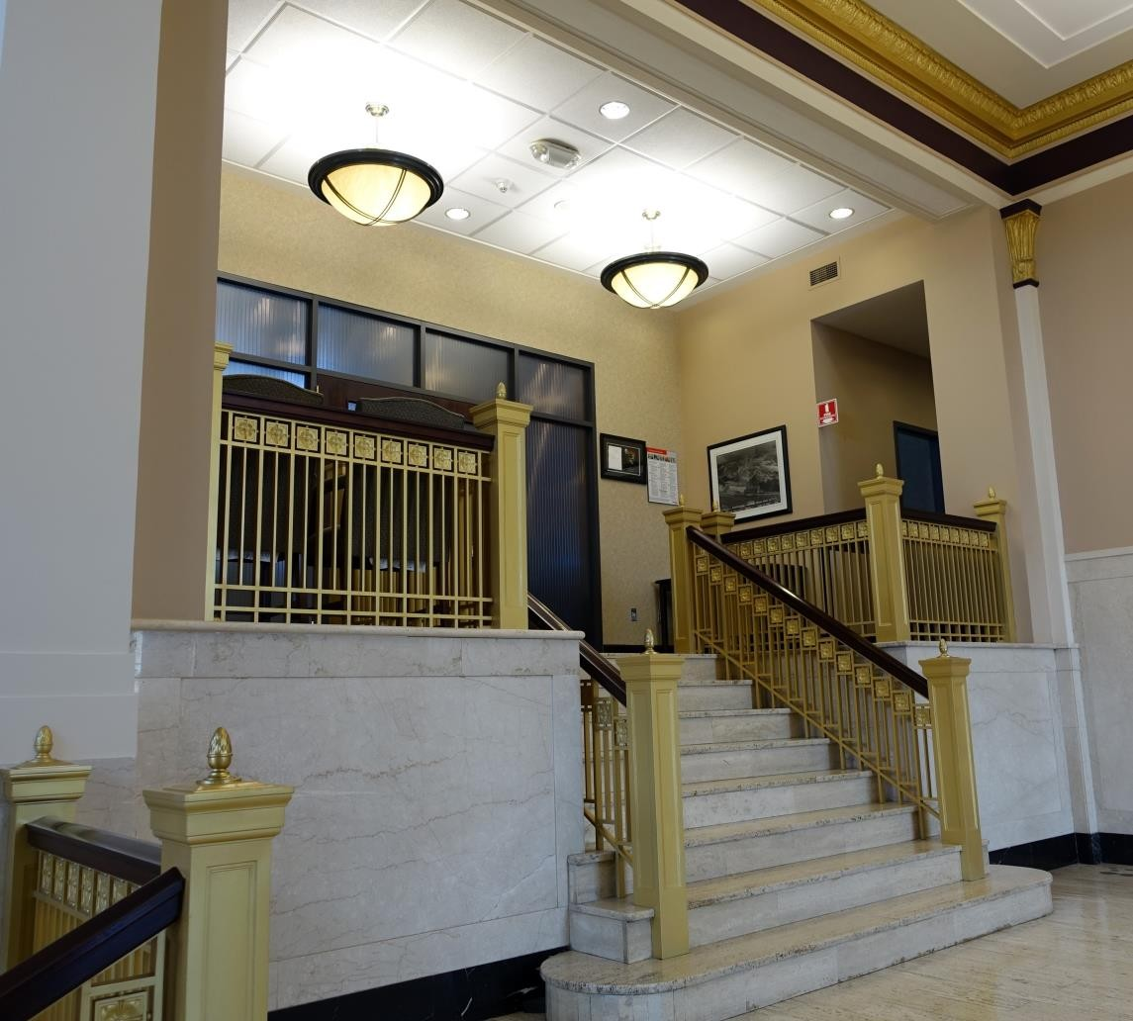
Field of Expertise with Tradition
More than 100 years ...

Slide 16
Power Systems started without Precision Timing
Much was achieved without precision timing
Established methods are seen as the reference
Paul Watzlawick – Psychologist, Author: Anleitung zum Unglücklichsein (Guide to Unhappiness) Wenn die Loesung das Problem ist (1987) (When the solution is the problem) https://www.youtube.com/watch?v=cl4aZTPsTSs
Precision timing-based methods are seen as "nice to have" extensions
Reliance on precision timing is not desired
The power industry has not yet fully embraced precision timing

Slide 17

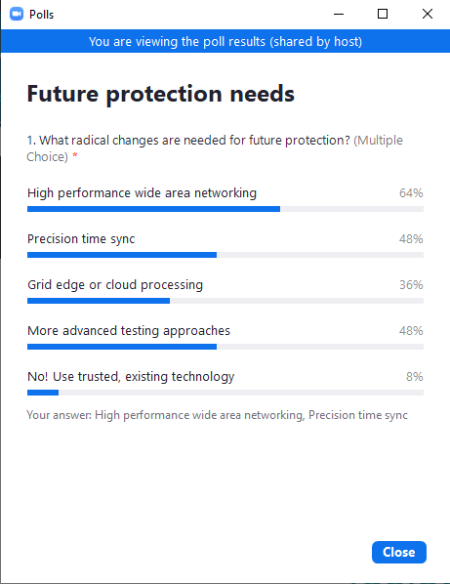
Lack of Embracement
Poll at webinar in March 2022
"Enabling wide area protection with IEC 61850"
Expected audience (at least for me)
Open minds
Familiar with time sync topic
Tech affine
Only 48% ...
... regarded precision time sync as a future need

Slide 18
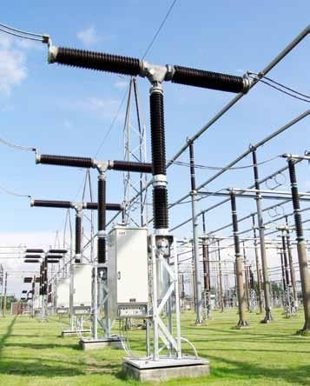
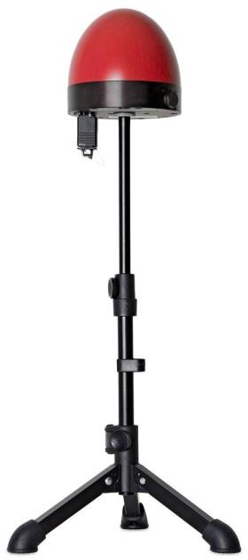
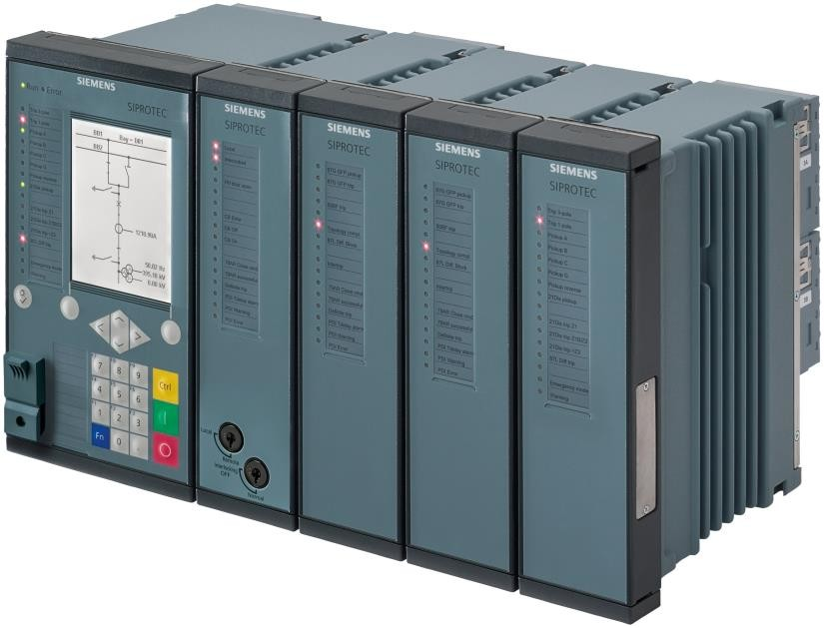
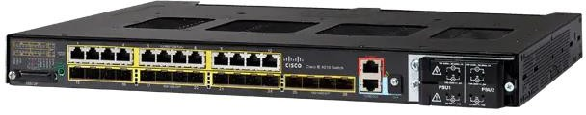
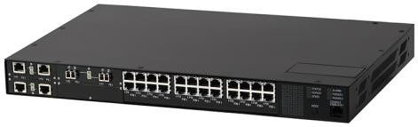
Power Utility Value Perception
GNSS/PTP
Master Clock
HV Circuit Breaker HV Protection Relay
Ethernet Switch
≈ 100 k€ | ≈ 10 k€ | ≈ 10 k€ | ≈ 5 k€
accepted ✓ | accepted ✓ | expensive ! | expensive !

Slide 19
Apprehensions
Emphasizing on threats
What if ...?
But there may be GNSS jamming!
But there may be GNSS spoofing!
...

Slide 20
Components vs. Solutions

Slide 21
What makes a Precision Timing Solution?
Components are readily available
GNSS receivers
Master clocks, boundary clocks
PTP and its parameters
PTP transparent Ethernet switches
Oscillators with long holdover time (atomic clocks)
....

Slide 22
Precision Timing System Integration
Putting the components together
Set of complex tasks
Designing the precision timing system Building the system
Configuring the system
Testing the system
Who can do that?

Slide 23


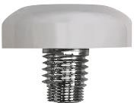
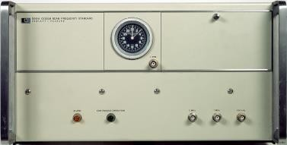
What I wish to see
GNSS 1 (e.g., GPS)
GNSS 2
(e.g., Galileo)
"All bases covered" solution
Perceived problems addressed
Solutions explained
Atomic clock
Holdover specified
Implementation described
Time assessor & dispatcher
Offer for the integrated solution
"Super Master Clock"
Precision time for the
Digital Substation

Slide 24
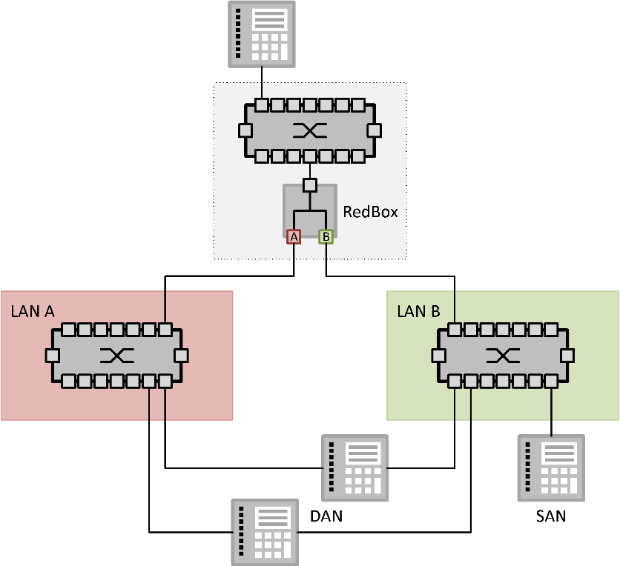
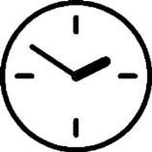
Redundant Time Synchronization
Reliable clock failover scenarios
Straps and belts can make things complicated
Best practice still evolving
Guidance welcome
To be thoroughly tested

Slide 25
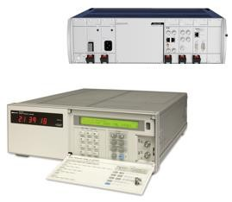

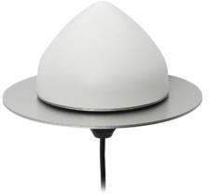




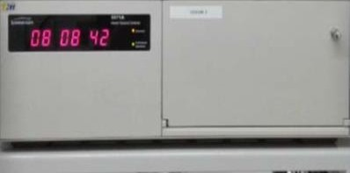




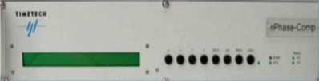
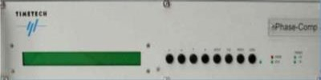
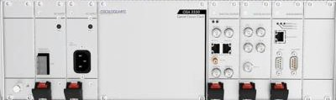

Timescale
GNSS
GNSS
Sentral Clocknode
Sentral Clocknode
ePRTC (cnPRTC)
Source: Presentation from Statnett (Norway) at
ITSF 2022
Cesium
Offset generator
Distribution amplifier / Phase comp
White Rabbitlink
Cesium
Offset generator Distribution amplifier

Slide 26
Time Appliance in the Electrical Power Industry

Slide 27
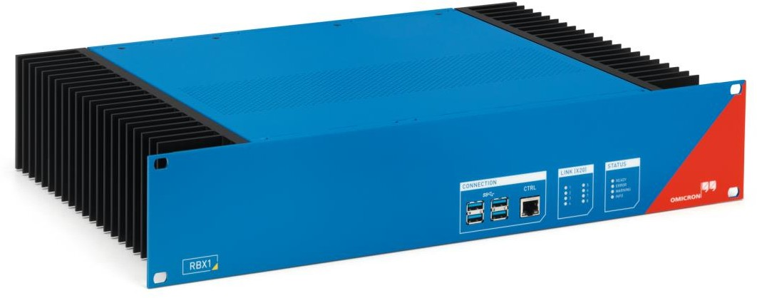
Substation Devices
Dedicated hardware
No habitat for a standard PCI card

Slide 28
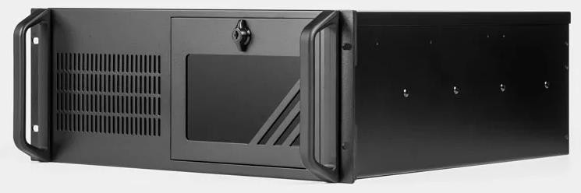
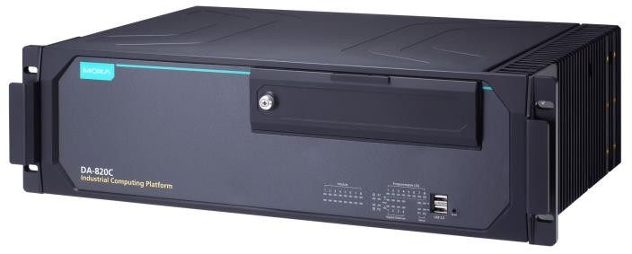
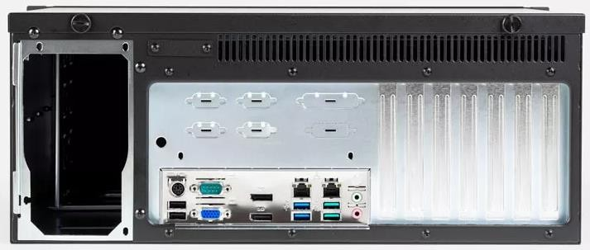
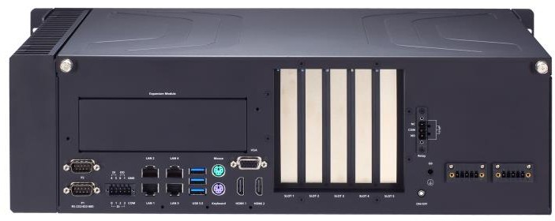
Trend: Application Servers
Virtualized devices
Possible habitat for a standard PCI card

Slide 29

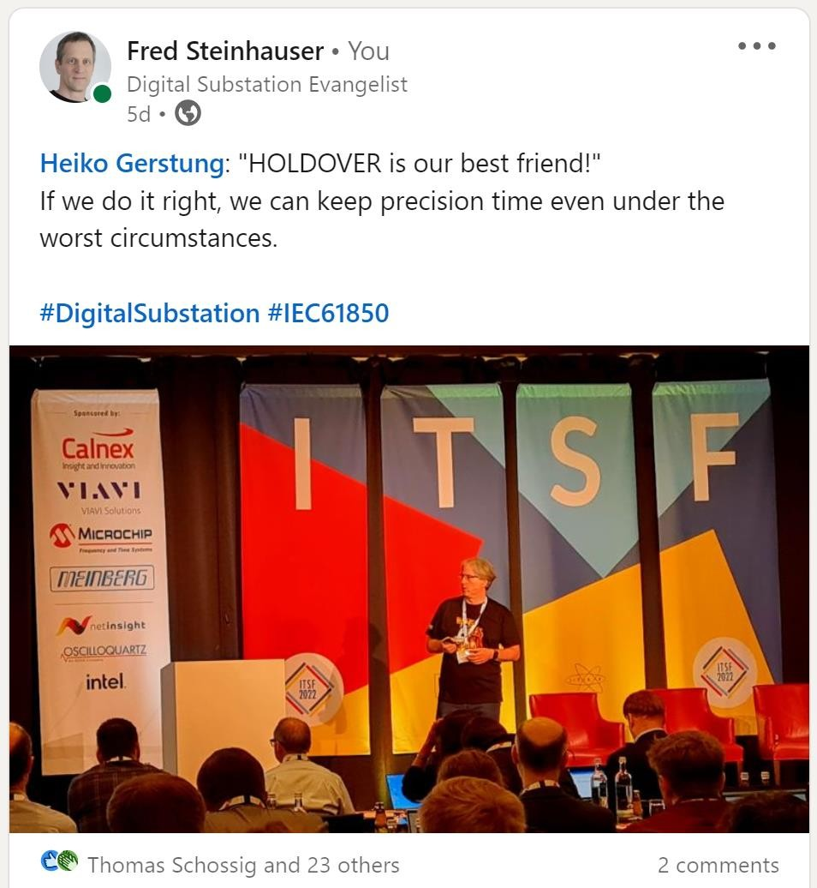
"Holdover is our best friend!"
Heiko Gerstung
ITSF 2022
Continuous delivery of time
No hiccups in dependent functions
due to intermittent time synchronization
Atomic clocks in servers "Chip Scale Atomic Clock "Micro Atomic Clock"
...

Slide 30
Open Source in the Electrical Power Industry

Slide 31



Open Source in the Electrical Power Industry
Linux Foundation - LF Energy
https://www.lfenergy.org/projects/
RTE - commitment to Open Source

Slide 32




Open Source in the Electrical Power Industry
https://www.alliander.com/en/open-source/projects/
https://www.lfenergy.org/projects/compas/
Open Source virtualization platform for centralized protection ?
IEC 61850 Engineering – OpenSCD

Slide 33
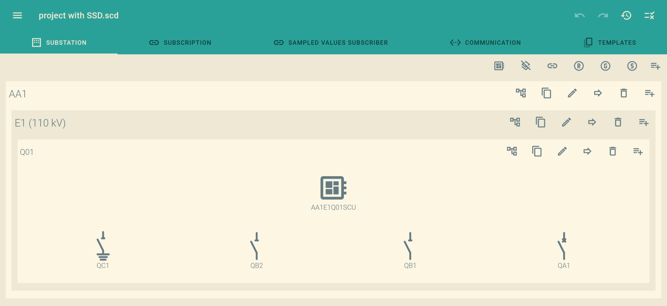
Manipulate IEC 61850 System Configuration (SCL)
https://OpenSCD.github.io

Slide 34
Summary

Slide 35
Let's summarize ...
Applications in power systems that benefit from or even require precision timing do exist
The value of precisely time synchronized systems is not yet fully recognized
Possible solutions exist but are not well known - must be better communicated and promoted
Application servers may be a habitat for the Time Card
Open Source projects are in progress

Slide 36


Thank you ...
... for your attention
fred.steinhauser@omicronenergy.com
www.linkedin.com/in/fredsteinhauser

